Slide 1

Intentions
iBrain Developer by

Slide 2
SPEAK YOUR SOFTWARE DEVELOPMENT INTENTIONS
IBRAIN MAKE
IT REAL
ABOUT US
INNOVATION ​
WITH SIMPLE AI SOLUTION.
2023
2

Slide 3
PROBLEM
Tight Deadlines & Technical complexity
Complex projects with tight deadlines require developers to have a deep understanding of complex technologies and excellent time management skills. However, these demanding circumstances can put significant pressure on developers, leading to increased stress and the potential for rushed or suboptimal solutions.
Debugging & Troubleshooting
Identifying and fixing bugs, performance issues, and compatibility problems can be time-consuming and require strong problem-solving skills. Debugging can sometimes be a complex and frustrating process.
Testing & Quality Assurance
Implementing comprehensive testing strategies, including unit tests, integration tests, and end-to-end tests, can be very demanding
Performance Optimization
Optimizing code and system performance, such as reducing response times and improving scalability, can be complex and require a deep understanding of the application and underlying technologies.

Slide 4

SOLUTION
Deadlines & complexity
Debugging & Troubleshooting
Developers can communicate their requirements and instructions through natural language to generate code snippets. ​
iBrain.codes can help with debugging tasks, assisting with identifying and resolving issues in code.​
Testing & Quality Assurance
Performance Optimization
The tool can also assist with testing, generating test cases and ensuring that code is functioning as intended.
The tool can assist with optimizing code, suggesting improvements or identifying areas that could be optimized.

Slide 5

How it works
"Our product combines the power of Large Language Models with advanced voice technology, unlocking the full potential of software development in a seamless and unprecedented manner."

Slide 6
# Service Section
BUSINESS MODEL
Offer a subscription-based model targeting individual developers or development teams.
Our costumers will be reached through our website, partnerships with development platforms, and online marketplaces.
v
BASIC
Code by intention
BUSSINESS
Code by intention Explain & Debug
PREMIUM
All features
$9.99
$29.99
$59.99
MONTHLY FEE
MONTHLY FEE
MONTHLY FEE

Slide 7
Go to market
Brand Positioning
Position iBrain Developer as the go-to solution for software development productivity.
Marketing Channels
Utilize online advertising, content marketing, social media, SEO, and industry events.
Sales Strategy
Consultative approach, personalized demos, free trials, competitive pricing, and exceptional customer service.
Distribution Channels
Website, online marketplaces, strategic partnerships for wide accessibility.
Advertising and Promotion
Targeted digital advertising, engaging content, webinars, tutorials, case studies.

Slide 8



Competition
Features
 | Askcodi | Denigma | CodePal | IBrain
Automation
Integration
Voice dictation
Comprehensive Features

Slide 9
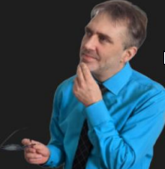

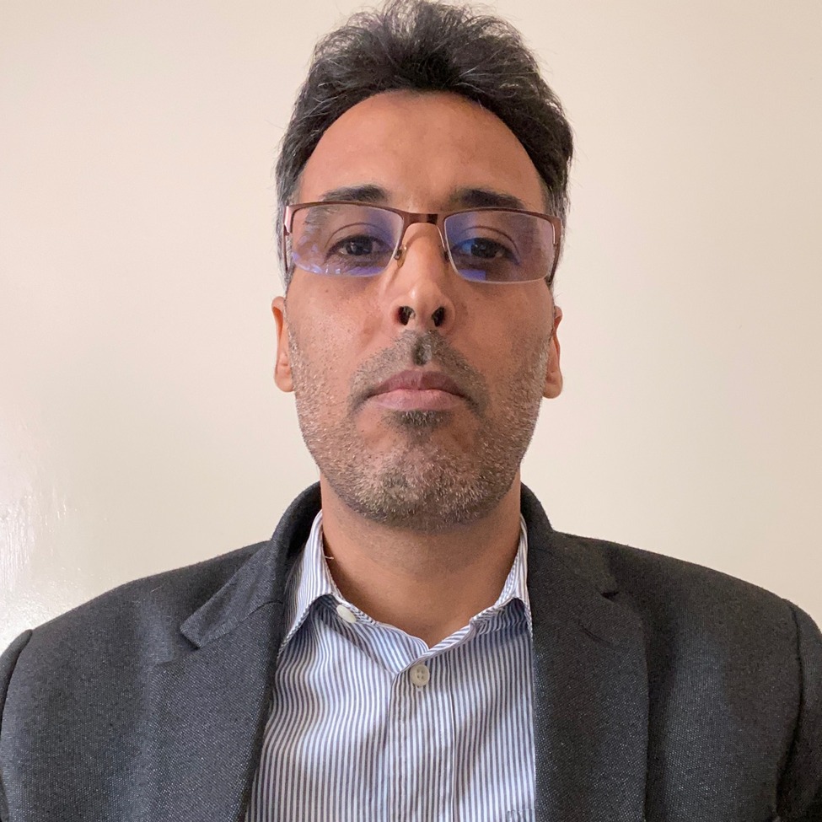


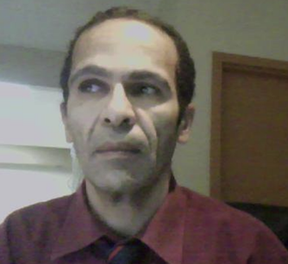
MEET THE TEAM
MARTIN OUMIET​
Sebastien Pesant
MHAMED BENCHERQUI​
Chief Executive Officer
Chief Business Development Officer
Chief Technology Officer
VP Marketing
AMIT BASUNIA
OBONGOFON UDOMAT
GHARBI HASSAN
Chief Product Officer
Chief Marketing Officer
Chief Scientist Officer

Slide 11
FINANCIALS
 | 2023 | 2024 | 2025
INCOME
Users | 2,800 | 6,250 | 8,300
Average price per sale | 12 | 20 | 30
TOTAL REVENUE | 400,000 | 1,500,000 | 3,000,000
Expenses
Marketing | 100,000 | 150,000 | 200,000
Operations | 70,000 | 140,000 | 180,000
Product development | 170,000 | 300,000 | 370,000
TOTAL EXPENSES | 340,000 | 590,000 | 750,000
NET INCOME | 60,000 | 910,0000 | 2,250,000
We are aiming to secure finance for the next 6 months.
$340 000

Slide 12
TWO-YEAR ACTION PLAN
PROOF OF CONCEPT
INFRASTRUCTURE
ETC
DELIVER TO CLIENT
PRE-RELEASE
2023
JAN
FEB
MAR
APR
MAY
JUN
JUL
AUG
SEP
OCT
NOV
DEC
2024
JAN
FEB
MAR
APR
MAY
JUN
JUL
AUG
SEP
OCT
NOV
DEC
…
…

Slide 13
SUMMARY
01
02
INTENTIONS & VOICE
Our software development approach is centered around discussing requirements, rather than solely relying on coding.
INNOVATION
It is the first solution to offer such a unique and valuable feature.
03
04
PRODUCT MVP
Our product has been developed and can be launched as an MVP in just two weeks.
STRONG PARTNERS
Our strong partnerships in the industry give us the trust and confidence to deliver exceptional results.

Slide 14


THANK YOU

